Slide 1
The Origin of 19×19 lines GO-Board -when, where, why (& how) 19×19 Go-board spread-
Ichiro TANIOKA, Ph.D.
Osaka University of Commerce
①
International Go Symposium (Aug. 4th 2012) at NC state, USA.

Slide 2
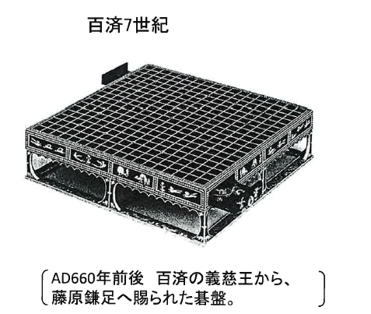
articles left by
Emperor Shomu
聖武天皇 (~756AD)
・The official record suggests
this Go-board was a gift from
義慈王(~660) of 百済(south
part of Choson Peninsula) to
a Japanese high official（藤原兼足）.
・This board has 17 stars！
Giji-ou
Kudara
②

Slide 3
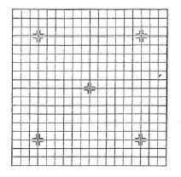
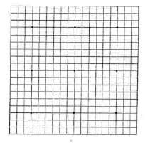
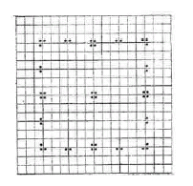
Go-Board and Stars (Early 20th Century)
China
Japan
Korea
19×19 lines
(5 stars)
19×19 lines
(9 stars)
19×19 lines
(17 stars)
③

Slide 4
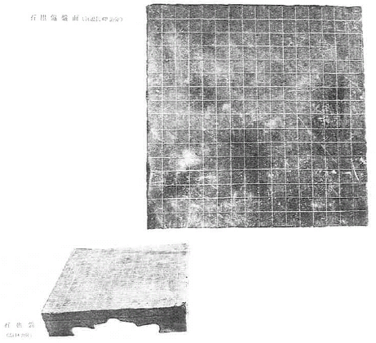
Go-Board was 17×17 lines ＜1＞
・Graveyard of a general （鄭将軍
~182AD） in 河北省望都県
(3rd century)
says, “Go-board has 17 vertical & horizontal lines; 289 points totally.”
Original document disappear.
Due to a memo of the Copy in Tong Dynasty (8C.)
④

Slide 5
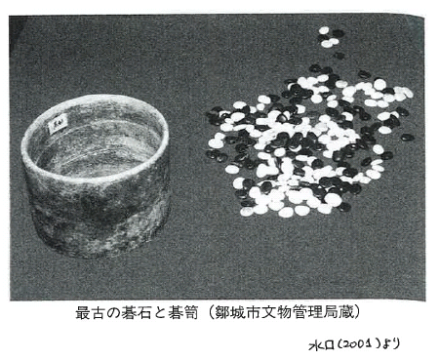
Go-Board was 17×17 lines ＜2＞
・A set of Go-stones was found
from the graveyard of 301 AD.(劉宝）.
Total number was 289 pieces.
( a collection of ［old］poems)
was edited in 440 by
which includes the poem of “17 lines Go-Board”.
・As the fact, in these era (by 4- 5th
Century) there is no description nor
archaeological find of 19×19 lines
Go-board.
Go-board was 17×17 lines by 4-5th Century.
⑤

Slide 6
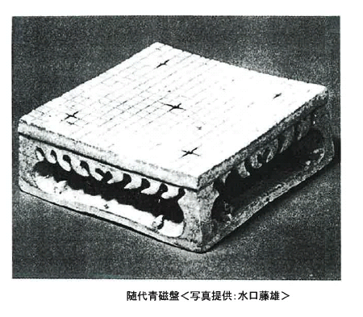
Emergence of 19×19 line Go-Board
・Known first 19×19 line Go-
board in Sui (隋) Dynasty
(589-618 AD).
・A poem of 北周 Dynasty
(～589） had the text “Go-board of 19×19 lines.”
⑥

Slide 7
Temporary Conclusion
17×17 lines
Go-Board
19×19 lines
Go-Board
Ca. 400 AD
(±50 years)
Ca. 580 AD
Question:
1 Why 19×19 lines Go-Board was made?
(and why 17×17 board disappear?)
2 Where was 19×19 board invented?
3 Who?
⑦

Slide 8
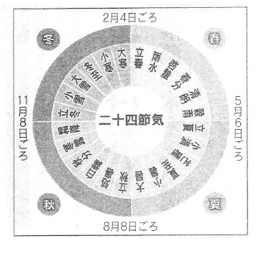
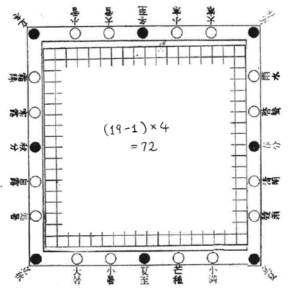
WHY＜1＞：24 Sub-Seasons/72 Periods
（ 24 節気 ）
（ 72 侯 ）
Solar Calendar
19×19 line Go-Board has 72 points on its outer frame.
⑧

Slide 9
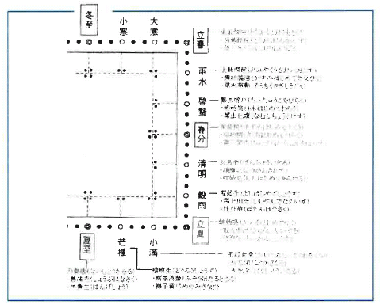
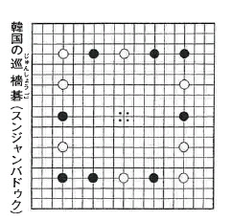
WHY＜2＞：Reform in Korea
Korean Std. Go-Board
Go-board (19×19) was used as visual indication apparatus of Solar-Calendar. (Which was, perhaps, improved in Korea further.)
⑨

Slide 10
WHY＜3＞：Proclamation by The Power
★Someone (probably an astronomer of the office of calendar-
making) suggested to the powerful person (Emperor?) that
“the Go-board shall be 19×19 lines (as the will of Universe/God)”.
★The Power decided that the official Go-board shall be 19×19
lines. ［official announcement/unification, proclamation］
(⇒thereafter, ranking of Go-skill must be decided by matches
played by 19×19 line Go-board)
⑩

Slide 11
WHERE?＜1＞：a hint from the letter
( Ki / Chi )
( Go)
棋
碁
棊
碁
棊
［木：tree］
［石：stone］
★The letter 「碁」 was (probably) created by
in Ca. 350 AD.
(first shown in his book
⑪

Slide 12
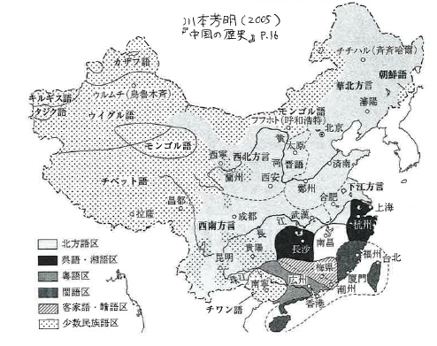
WHERE?＜2＞
・in Japan, the letter “碁” is only
pronounced “Go”, not “Chi” nor “Ki”.
・Pronouncing “Go” is the feature of
southern part of China. “Ki” is in
northern part.
(⇒ unified in Sui-Dynasty［601AD］.)
・Japanese Go game is imported from South China.
・It must be after the letter “碁” was made, and before all the
pronunciation was unified. Say 350-601 AD.
⑫

Slide 13
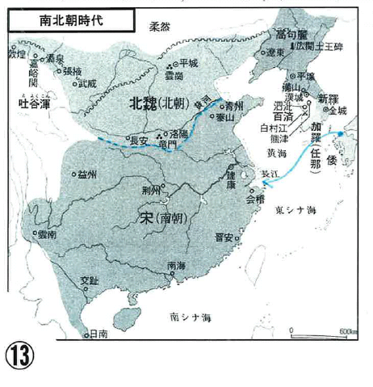
WHERE?＜3＞
Sothern part of China
東 晋 317～420
南 宋 420～479
These are era of cultural progress.
Especially, 東晋 era is called “Renaissance in China”.

Slide 14
Background (social/political) in E. Asia (4~5 century) ＜1＞
［冊封体制］
Sakuho-System
China
(local) King
Japan King（大和王/倭王）
Korea King
（百済・高句麗 / 朝鮮王）
・The local leaders give loyalty and gifts.
・The Emperor gives a right to use title “King（王）” locally,
(also gives a right to monopolize trade permission.)
⑭

Slide 15
Background in E. Asia (4~5 century) ＜2＞
［冊封体制］
Accepting Sakuho-System means also accepting:
・religion/philosophy (priest/shaman/prophet)
・unified calendar
Chinese
(Shaman prophet)
＞
local
(Shaman prophet)
Pride? or (reluctantly) Accepting Sakuho?
⑮

Slide 16
Genka- Calendar（元嘉暦）
445
510
550
600
China（宋）
［大明暦］
Korea
554
602
604
Japan
archeological fact
(evidence of Usage of Genka-C.)
official adoption
・In Korea（百済）, Genka-C. was adopted and used (→improved).
・In Japan（大和）, Genka-C. had been used but not adopted until the year 604.
・The person who adopted in Japan in 604 AD is .
He is pious Buddhist and had a reason to respect Chinese shaman (Buddhism
priest) than local ones.
⑯

Slide 17
Unified Hypothesis ＜1＞
・The concept of 19×19 line Go-board was made at 東晋 in
late 4th Century.
・When new calendar was established, the power (Emperor?)
also made apparatus to indicate 72 periods of Solar-Calendar
year. It was 19×19 Go-board.
・ (early timing after 445 AD.) The new calendar (Genka-C.) and
19×19 Go-board was given to missionaries from local
government.
・Kudara（百済）accepted Sakuho-System (and new calendar)
quickly, and improved the Go-board so that 24 sub-season to
be indicated more nicely.
⑰

Slide 18
Unified Hypothesis ＜2＞
Genka-C.
元嘉暦
19×19
board
445
＋
unofficial
usage of Genka-C.
・ ・ ・ ・ ・
improved
board
554 lecture
・ ・ ・
・
・ ・ ・
602 lecture
・ ・ ・ ・ ・
adoption of
Genka-C.
604
⑱

Slide 19
Official Missions to China
◎445
元嘉暦
(several missions
to 宋＆北魏）
⑲

Slide 20
WHO?
320
370
420
470
東 晋
南 宋
何 承 天 （Ho Tsuntien）
虞 喜 （Yui Si）
祖 沖 之 （Tzu Tsuonzu）
・astronomy & mathematics progressed in these era.
・There is no clear hint of who?
⑳

Slide 21
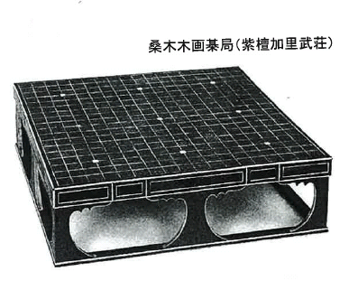
★Once again I should confess this hypothesis is just a hypothesis.
★Yet, it explains well and no contradiction.
★Believe or not is up to you.
Thanks!
Q &A
21

